Slide 1
Entrepreneurship & Innovation Group
Entrepreneurship: Stories, Myths and Legends
By: Gordon McConnell
Assistant Vice-President
Entrepreneurship and Innovation

Slide 2
Who am I?
First ‘startup’ in college
Started career originally in marketing and PR
Various corporate roles e.g. Westinghouse; Accenture; Strategy Practice
Two funded start-ups, early stage venture capital, solopreneur
Dublin City University – Head of Strategy, Chief of Staff
Ryan Academy for Entrepreneurship – Deputy-CEO
Founder/Director of the Propeller Venture Accelerator
Taught entrepreneurship in several Universities and Colleges
Now head of the ASU Entrepreneurship and Innovation Group

Slide 3
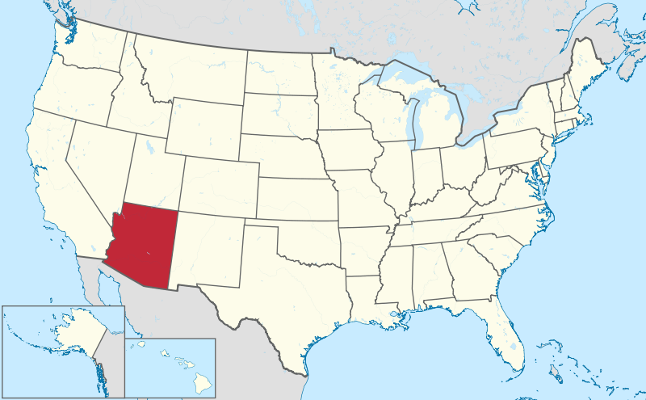
Arizona – Emerging Startup Ecosystem
Arizona is a developing ecosystem – can adapt, adopt from Silicon Valley but you cannot replicate it
State has 6.5 million people, 4 million in Greater Phoenix Area
ASU has 73,000 students on 4 campuses – biggest single university in the US
State has suffered badly from recession – one of the worst states for venture funding

Slide 4
Create Like a God Command Like a King Work Like a Slave Ref: Guy Kawasaki (Ex-Apple, Garage.com)

Slide 5
ASU Entrepreneurship and Innovation Group (EIG) Overview
Tasked with a wide role of helping coordination of entrepreneurship activities across the university, as well as specific task to manage ASU’s startup activities (student, staff, external)
Manages the incubation & accelerator initiatives in ASU including:
Student startups (Edson student startup accelerator, new Great Little Companies (GLC) Network)
Supports faculty spinouts after licensing occurs with ASU’s AzTE (ASU Startup Accelerator)
Runs state-wide technology transfer accelerator that turns unused Intellectual Property into startup companies (Furnace Technology Transfer Accelerator)
Supports a growing network of startup coworking spaces in the public libraries (Alexandria Coworking Network)
Named one of the top 20 University Incubators in the world 2013 by the UBI Index (10th in the US); winner of the national award for ‘Emerging Technology Based Economic Development’ (SSTI)

Slide 6
Entrepreneurship@ASU – A Permanent Revolution

Slide 7
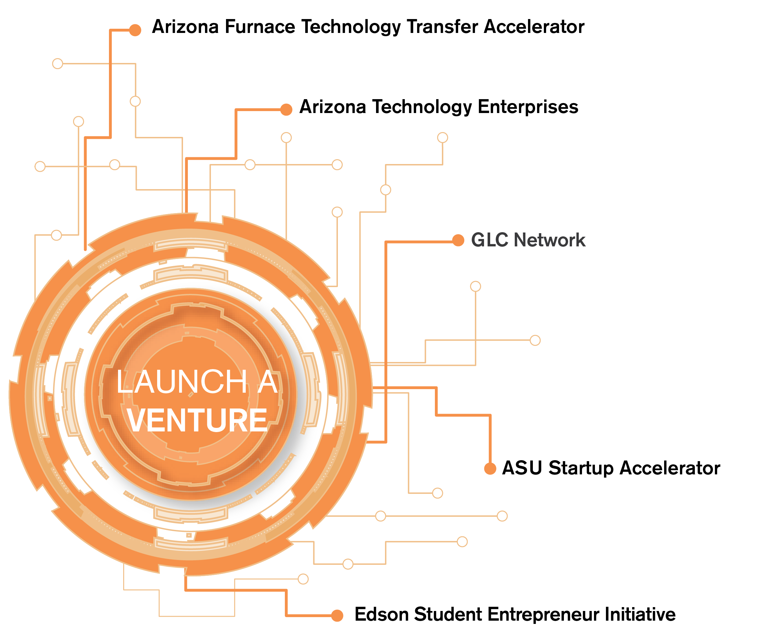
(EIG initiative)
(EIG initiative)
(EIG initiative)
(EIG initiative)

Slide 8
2013/2014 Estimates Key Indicators
48 student startups supported (20 last year)
$400,000 in initial funding from private donors to these student startups including new patent/TM fund, customer development travel fund ($200,000 last year)
15-18 new faculty startups created (11 last year)
10 alumni/external startups supported (4 last year)
4 Alexandria Co-working Spaces open (1 to date)

Slide 9
What Makes a Great Business?
Great People
Well Differentiated Product
Must Have Customers
Sufficient Infrastructure and Resources

Slide 10
Why are people getting into entrepreneurship?
Costs are falling…. Off-the-shelf technologies & platforms
Coding is being ‘democratized’ for internet startups
Financial crash has made people re-assess their aims and futures
No longer seen as a ‘crazy’ idea – now a real career choice
Rapid growth of support structures

Slide 11
Trends
Growth in hybrid business models e.g. Change.org, social enterprises
Interest in physical products and manufacturing
3D printing and Rapid Prototyping will revolutionize certain industries
Crowd sourcing and crowd funding
Health technologies, Big Data

Slide 12
Rules for doing a high tech startup are the same … but….
Internet or Web 2.0 are the ‘easiest’ to advance
Pure software take a little longer…
Hardware generally takes a little longer than that and costs more for development
Medical devices take longer again and are also capital intensive
Biotech or pharma take the longest, are higher risk, take more investment but have high rewards
And there are non-traditional startups too….

Slide 13
Question: Which would you invest in A. Great Idea, good team or B. Good idea, great team?

Slide 14
Where they ended up was not where they started….

Slide 15
Startup Teams – Ability to ‘Pivot’
Many successful startups go through some form of a ‘pivot’, changing their direction when their first idea was not successful.
For Example:
PayPal was originally about beaming money between Palm Pilots
YouTube was originally a video dating site
Twitter was about Group SMS
Groupon started as a website for collective political action
The Google founders tried to sell the algorithm to other search engines
Steve Jobs tried to get Atari and HP to take them and the original Apple on as a project
Easier to switch models for software/internet/Apps than devices or biotech
Early customer engagement often changes the business model, positioning, competitive advantage

Slide 16
Entrepreneurship is risky because…..?
Few entrepreneurs actually know what they are doing
They lack the methodology
Management incompetence
Poor financial control (cash flow!)
Failure to develop a plan
Uncontrolled growth (cash flow)
Improper inventory control (cash flow)

Slide 17
Entrepreneurship is a ‘Minority Sport’ that only suits certain types
Some Sobering Thoughts…
The average working week for a self employed person is 64 hours
Most people do not increase their income by becoming self employed
1 in 5 Entrepreneurs do not earn anything within the first 12 months
Support of the spouse or partner is critical (3 F’s)
50% of all new businesses in fail in the first 12-24 months

Slide 18
Push the Team Idea
Nothing like the feeling of running your own business….
But it takes commitment….
…and you can’t do it alone….
Investors look for TEAMs ….who can ‘ship product’

Slide 19
“Real Artists Ship!” Steve Jobs, Founder of Apple

Slide 20
Start with a broad view of the sector ….and look for the gaps Look for unfulfilled Needs Look for problems to be solved TALK to customers early

Slide 21
Business Plans versus Lean/BMC Startup
Business plans are falling out of favor
Being replaced by lean thinking including the Business Model Canvas (BMC)
BUT banks and funders still seek the 3-5 year business plan
BMC can help develop a business plan easily

Slide 22
The road to being a startup is not straight….
Some entrepreneurs are ‘born’ to do a startup e.g. Richard Branson, Bill Gates
Some fall into it by accident e.g. Steve Jobs
Some wanted a particular product in a particular way e.g. Anita Roddick
Some developed college projects e.g. FedEx
Some were research students in universities e.g. Google, Yahoo

Slide 23
Entrepreneurship – a story

Slide 24
“The critical ingredient is getting off your butt and doing something. It's as simple as that. A lot of people have ideas, but there are few who decide to do something about them now. Not tomorrow. Not next week. But today. The true entrepreneur is a doer, not a dreamer.”
Nolan Bushnell, founder of Atari

Slide 25
A journalist and an artist in 1977…..

Slide 26
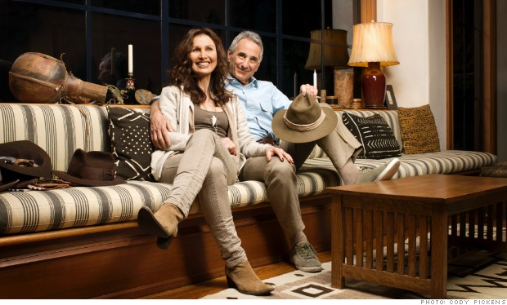
In the late 1970S Banana Republic pioneered a new form of storytelling as marketing, filling its catalogues with tales of jungle treks and safaris. Former journalists Mel and Patricia Ziegler, now 67 and 63, respectively, spun their yarns into retail gold.

Slide 27
“We came up with the idea of Banana Republic by fantasizing about the source of our merchandise.”
“We'd work until we were exhausted, go home, open the mail, and take the dollars from the envelopes to go to dinner.”
These quotes are from the March 18, 2013 issue of Fortune magazine

Slide 28
By the end of 1982 the firm had $2.5 million sales (80% margins) with no outside investment
Gap buys Banana Republic in Feb 1983; start to create their own private label goods
By 1988 they had 100 stores and turnover of $250 million
They left after a disagreement on strategy with Gap

Slide 29
Lean and business model canvas

Slide 30
I never perfected an invention that I did not think about in terms of the service it might give others... I find out what the world needs, then I proceed to invent Thomas Edison, inventor and scientist

Slide 31
Lean thinking states that a startup is ‘temporary organization’
First we have untested hypothesis so we conduct a system of ‘search’ for a value proposition
Use the business model canvas as a framework for testing these hypothesis with customers
This means customer discovery (talking to, not selling to)
Repetitive process as we glean more information
This goes with agile development (software, engineering) in which we speed up product development (iterative, incrementally)

Slide 32
Objective of all this?
Our search for a business model will result in success (or we change direction or ‘pivot’)
Find a value proposition backed by multiple customer interactions
A business model to allow us to deliver on this value proposition
That we have a scalable business (depends on what you mean by this)
That we can get/keep/grow our customer base

Slide 33
Lean Thinking suits evolutionary product innovation
Less applicable for radical product innovation
Business Model Canvas is a useful tool
Has some weaknesses

Slide 34
“The greatest risk is not in the development of new products, but the development of customers and markets.”
STEVE BLANK
The Four Steps to the Epiphany

Slide 35
Myths we tell ourselves

Slide 36
The world of entrepreneurship is full of myths and half truths

Slide 37
Where do entrepreneurial ideas come from?
Passion
“I Love doing this…”
Opportunity
“There is a gap that needs to be filled’
Despair
Small ‘d’ – “This is annoying…” – Apps
Big ‘D’ – “This shouldn’t be happening…” – Social enterprises
Situational
Unemployment, change in life

Slide 38
passion

Slide 39
People often start with what they like….even broken laser pointers….in 1995

Slide 40
These Entrepreneurs are a bunch of clowns…
it was founded in Canada in 1884 by two street performers Guy Laliberte and Daniel Gauthier
Cirque du Soleil shows have since been seen by more than 90 million people worldwide.
In 2006, Laliberté was named the Ernst and Young Entrepreneur of the Year
Its shows employ approximately 4,000 people from over 40 countries
Total revenue over $1 billion a year…during the 1980’s the company almost went bankrupt several times (familiar story…McDonalds, Virgin etc)

Slide 41
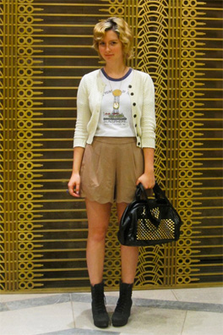
People often start with something they love….modcloth.com
Susan Kroger loved vintage clothing….
Set-up an online store from her Carnegie Mellon dorm room at 17….
Then moved into a house/office….
Now has over 100 employees
“Growing up I always had a passion for thrifting…” Susan Kroger

Slide 42
Opportunity

Slide 43
Sometimes products are developed by accident…..
Microwave oven…..super glue…..pacemaker…….polio vaccine…..X-Ray…..penicillan….
Viagra was intended to treat hypertension. Cellophane was meant to be a waterproof tablecloth. Play-Doh was originally wallpaper cleaner
Teflon developed by DuPont (Plunkett) but were actually looking for an alternative to Freon gas

Slide 44
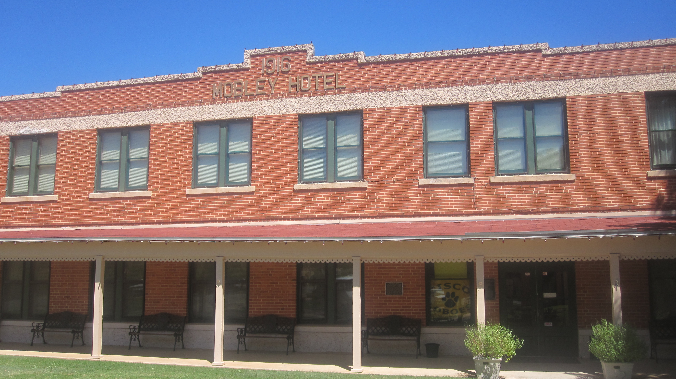
Starting one at a time…and changing your mind to catch an opportunity….
Your knowledge?

Slide 45
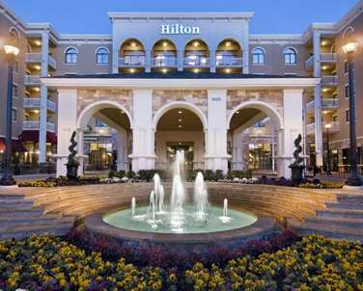
The Hotels have gotten bigger…..

Slide 46
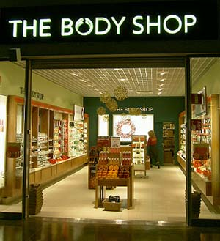
It wasn’t their idea…..but that didn’t stop them

Slide 47
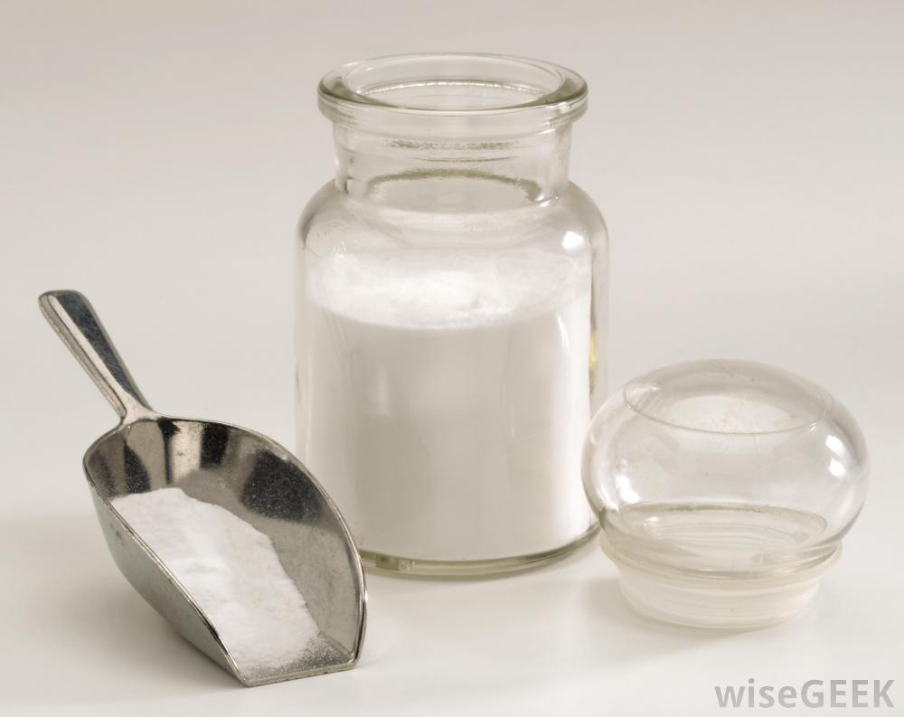
A Salesman in Chicago….selling baking soda

Slide 48
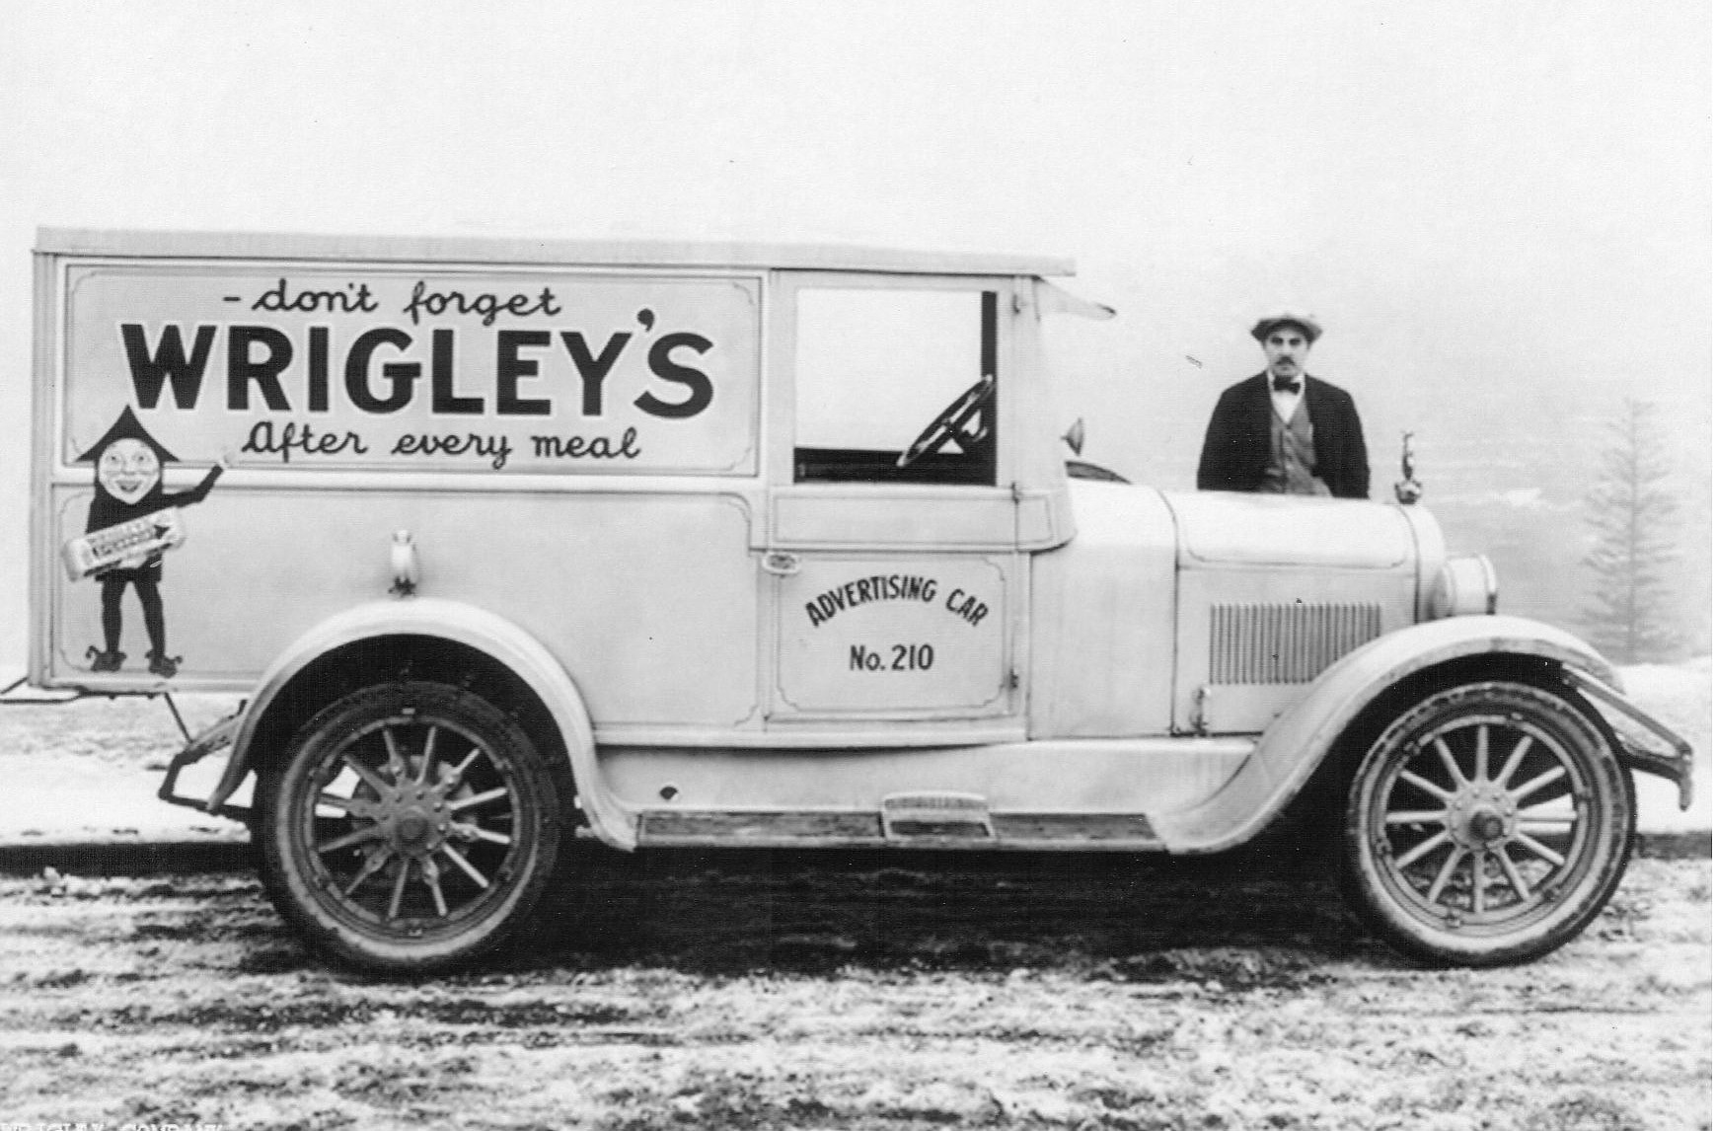
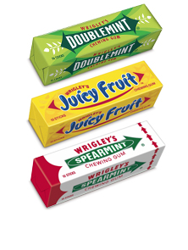
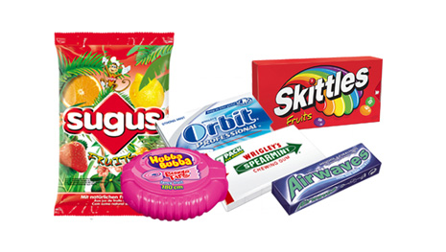
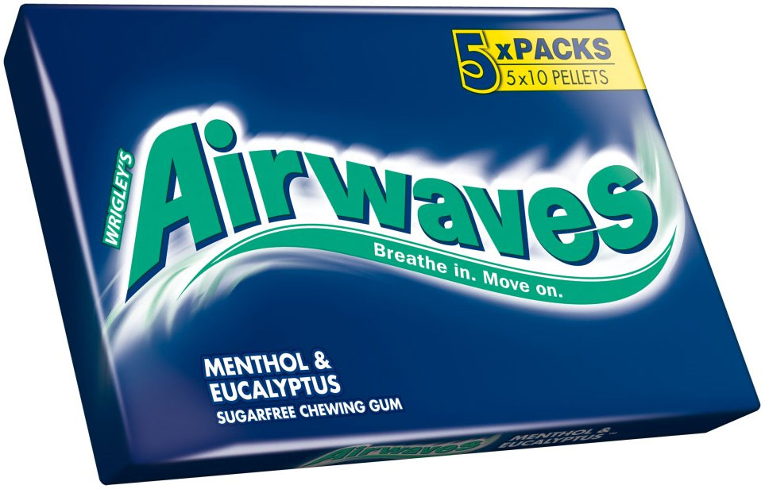
How to spot a good thing....and being brave enough to switch

Slide 49
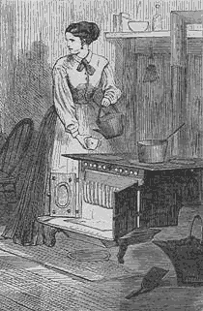
Tom Lyle Williams - From accident to empire

Slide 50
Even his sister said it would never work….

Slide 51
They even revolutionalize products and markets they know nothing about….

Slide 52
despair

Slide 53
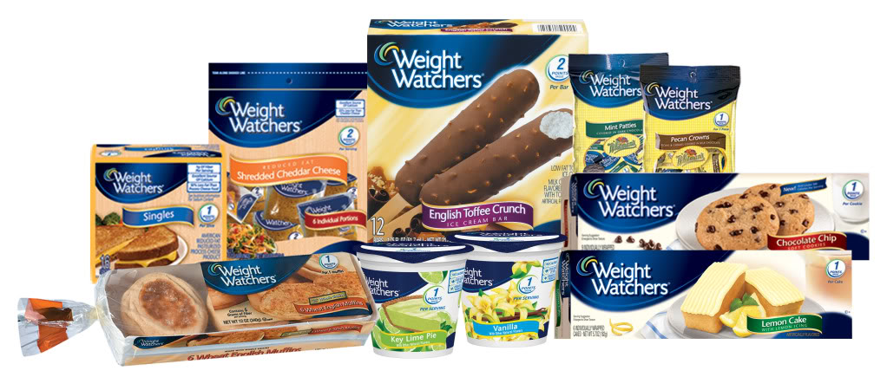
Personal Issues can spur innovation

Slide 54
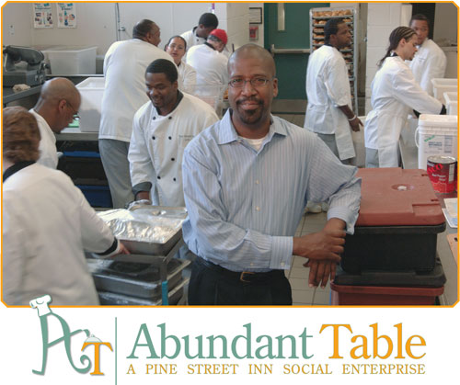
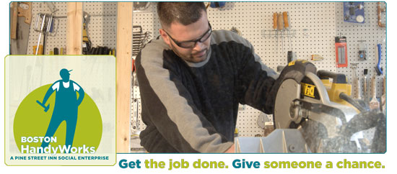
Big ‘D’ - Example of Social Enterprise
More-than-Profit
CHARITY
Gives Profit
Created/owns
3,000 meals a day
Support Pine Street Inn’s Food Service Training Program
Trains participants while they assist in food preparation
Gives Profit
Created/owns
More-than-Profit

Slide 55
Situational

Slide 56
Paying for a college degree by working for himself…Fred DeLuca opened a sandwich shop

Slide 57
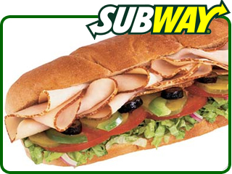
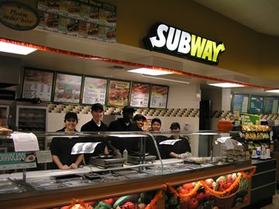

Slide 58
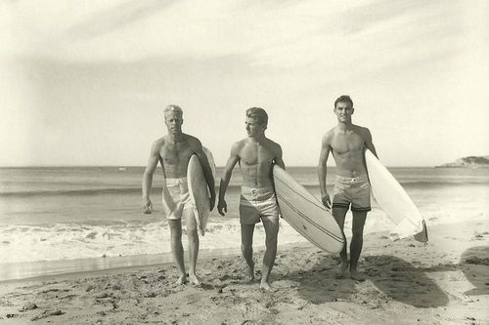
Australia 1969….bad surfer shorts and cold feet

Slide 59
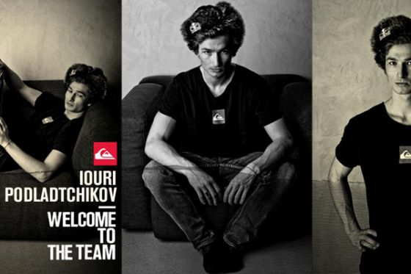

Slide 60
A pharmacist in Atlanta City needed more money for a growing family…..found a patented drink that was growing in popularity…bought it off its owner in 1880’s

Slide 61
The drink did quite well!!!!!!

Slide 62
"The real act of discovery consists not in finding new lands but in seeing with new eyes." Marcel Proust

Slide 63
Wrap up

Slide 64
…why work on a start-up, spin-out company of your own?

Slide 65
….And sometimes a bit of luck… (right time, right place) ….what they call chutzpah!

