Slide 1
Entrepreneurship & Innovation Group
Entrepreneurship@ASU
A Permanent Revolution By: Gordon McConnell
Assistant Vice-President
Entrepreneurship and Innovation

Slide 2
Who am I?
First ‘startup’ in college
Started career originally in marketing and PR
Various corporate roles e.g. Westinghouse; Accenture; Strategy Practice
Two funded start-ups, early stage venture capital, solopreneur
Dublin City University – Head of Strategy, Chief of Staff
Ryan Academy for Entrepreneurship – Deputy-CEO
Founder/Director of the Propeller Venture Accelerator
Taught entrepreneurship in several Universities and Colleges
Now head of the ASU Entrepreneurship and Innovation Group

Slide 3
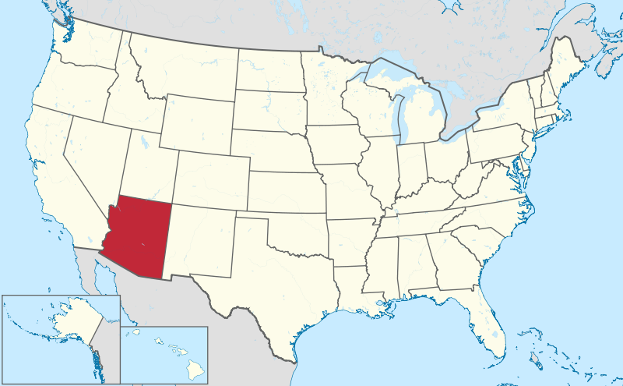
Arizona – Emerging Startup Ecosystem
Arizona is a developing ecosystem – can adapt, adopt from Silicon Valley but you cannot replicate it
State has 6.5 million people, 4 million in Greater Phoenix Area
ASU has 73,000 students on 4 campuses – biggest single university in the US
State has suffered badly from recession – one of the worst states for venture funding

Slide 4
ASU has become a top ranked university
ASU is ranked 73rd in the world and 46th in the U.S. by the Center for World University Rankings.
The organization evaluated more than 16,000 universities, taking into account quality of faculty members, published research, influence, citations, patents, alumni, employment and quality of education
ASU is ranked 79th in the world by the Academic Ranking of World Universities, 46th among all universities in the United States and 25th among all public U.S. universities.
Compiled by Shanghai Jiao Tong University, the rankings compared more than 1,000 higher education institutions worldwide and are considered one of the most prominent world university rankings

Slide 5
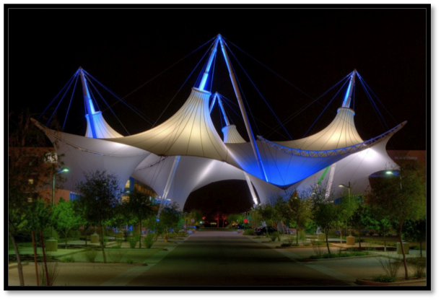
SkySong Innovation Center

Slide 6
SkySong Overview
A 42-acre mixed-business-use development located in Scottsdale, Ariz.
A public-private partnership
A joint venture with the university, city of Scottsdale, ASU Foundation and Plaza Companies
Home to a global business community
Links technology, entrepreneurship, innovation and education
Positions ASU and Greater Phoenix as global leaders of the knowledge economy
More than 800 tech-related jobs
97 percent capacity
Buildings 3 & 4 in planning stages; 400 apartments under construction

Slide 7
SkySong Overview
Designed to:
Create an ecology of collaboration and innovation
Target high-profile technology enterprises and related researchers
Advance global business objectives of on-site enterprises
Raise Arizona’s profile as a global center of innovation
Create a unique regional economic and social asset
Tenants range from large companies such as Ticketmaster to early-stage startups – over 80 companies

Slide 8
ASU SkySong Overview
ASU SkySong, also known internally as Economic Development and Corporate Engagement (EDCE),
a unit of the Office of Knowledge Enterprise Development, the research wing of the university.
Occupies two floors of SkySong Building 1
Consists of three sub-units, including the Entrepreneurship and Innovation Group at ASU
Originally created in October 2010 as ASU Venture Catalyst
Renamed in June 2013 as the EIG
Works with 50-75 startups a year (student, faculty, external)

Slide 9
ASU Entrepreneurship and Innovation Group (EIG) Overview
Part of the Research wing of the university (OKED)
Works closely with AzTE (ASU’s technology transfer arm)
Coordination of entrepreneurship activities across the university
Manages the incubation & accelerator initiatives in ASU including:
40-50 student startups a year (Supports faculty spinouts after licensing occurs
Runs state-wide technology transfer accelerator
Supports a growing network of startup coworking spaces in the public libraries

Slide 10
ASU Entrepreneurship and Innovation Group (EIG) Overview
Named one of the top 20 University Incubators in the world 2013 by the UBI Index
18th in the world
10th in the US
Winner of the US national award for ‘Emerging Technology Based Economic Development’ (by SSTI organization)
Develops Public/Private Partnerships e.g. Microsoft alliance
Founding member of Techstars ‘Global Accelerator Network’ (GAN)
Strong collaboration with local and state governments e.g. Arizona Commerce Authority

Slide 11
What do we mean by Entrepreneurship and Innovation at ASU?
Having a wide interpretation of ‘Value Entrepreneurship’ in the design aspirations of the New American University including:
The widespread and ‘democratized’ teaching of E&I modules, programs across the whole university, in all schools, on all campuses
All colleges, all programs covered; over 85 undergraduate and graduate level classes taught
Also evangelizing entrepreneurship and innovation as a ‘mindset’; a way of looking at the world, a new form of problem solving, critical skills for the 21st century graduate
Supporting the creation of purely commercial ventures and also hybrid models such as B-Corps, Social Enterprises, More-than-Profits, spin-outs from research

Slide 12
University-wide measurement of Entrepreneurship
Landscape – what does the university offer? (mapping)
Engagement – what level of engagement (year-to-year, student and staff) does the university get?
Outputs – What the are quantifiable outputs and are these the right ones?
Impact – What short/medium/long-term impacts can we see from the LEO model e.g. investment, survival…but WHAT can we claim?

Slide 13
Snapshot of Key Performance Indicators for Entrepreneurship@ASU Year ending June 2013
LANDSCAPE
(What do we offer?)
ENGAGEMENT
(How many are doing/finishing?)
OUPUTS
(What activity is coming out of all this?)
IMPACTS
(What’s the long term results?)
56 Undergraduate classes
20 supported student startups
67 faculty spinouts to date
4980 undergraduate students
35 graduate classes
$200,000 initial funding to student startups
$400 million in external funding to faculty spinouts to date
785 graduate students
8 Certificates
2012/13
266 invention disclosures
4 undergraduate degrees
$68 million in venture funding to faculty spinouts during year
47 new patents issued
12 graduate degrees
11 new faculty spinouts created
10 Rapid Startup School courses
6 Rapid Startup School courses
87 Rapid Startup School classes
605 Rapid Startup School participants
48 Rapid Startup School classes
934 Rapid Startup School participants
297 mentors

Slide 14
2013/2014 Estimates Key Indicators
48 student startups supported (20 last year)
$400,000 in initial funding from private donors
A new patent fund, customer development travel fund ($100,000)
15-18 new faculty startups created (11 last year)
10 alumni/external startups supported (4 last year)
65 Rapid Startup School classes (48 last year)
700 Rapid Startup School participants (605 last year)
330 Mentors (297 to date)

Slide 15
Entrepreneurship@ASU – A Permanent Revolution

Slide 16
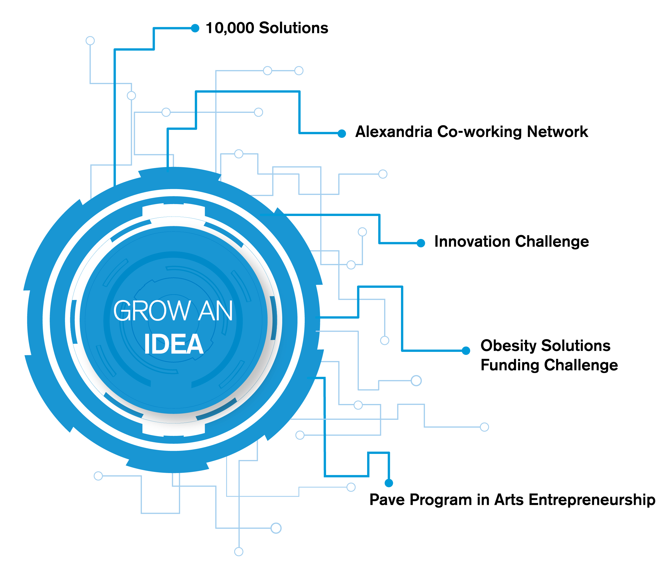
(EIG initiative)

Slide 17
Alexandria Co-working Network
‘Hub and Spoke’ model with designated public libraries
Create collaboration spaces in each of the libraries:
Co-working ‘light’ – open to anyone
Place for entrepreneurs, innovators and inventors to network, get advice, meet potential team members, work on their ideas
Access to pracademic teaching modules from EIG’s Rapid Startup School (RSuS) as well as other free providers
Access to ASU EIG mentor pool as well as other non-ASU mentor groups
Layout includes white board and lean canvas material from EIG
Pilot location is getting 2,500-3,000 users per month, new companies are forming

Slide 18
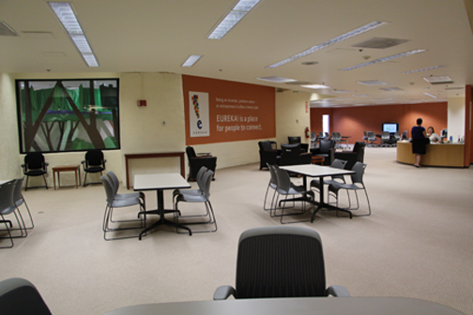
Pilot Alex location: Flexible, reconstituted space
Location: Alexandria Coworking Network location at the Scottsdale Public Library

Slide 19
(EIG initiative)

Slide 20
Rapid Startup School (RSuS) – Pracademic training
Pracademic, free, evening startup program
Run in SkySong and external locations
Aimed at graduate students, doctoral students, postdoctoral researchers, alumni, retirees
Delivering Lean Launchpad based on the Steve Blank (Silicon Valley) lean methodology
Currently running different Rapid School programs for 2013:
- Rapid Fund Raising School
- Using RSuS as a platform for ALL startup initiatives

Slide 21
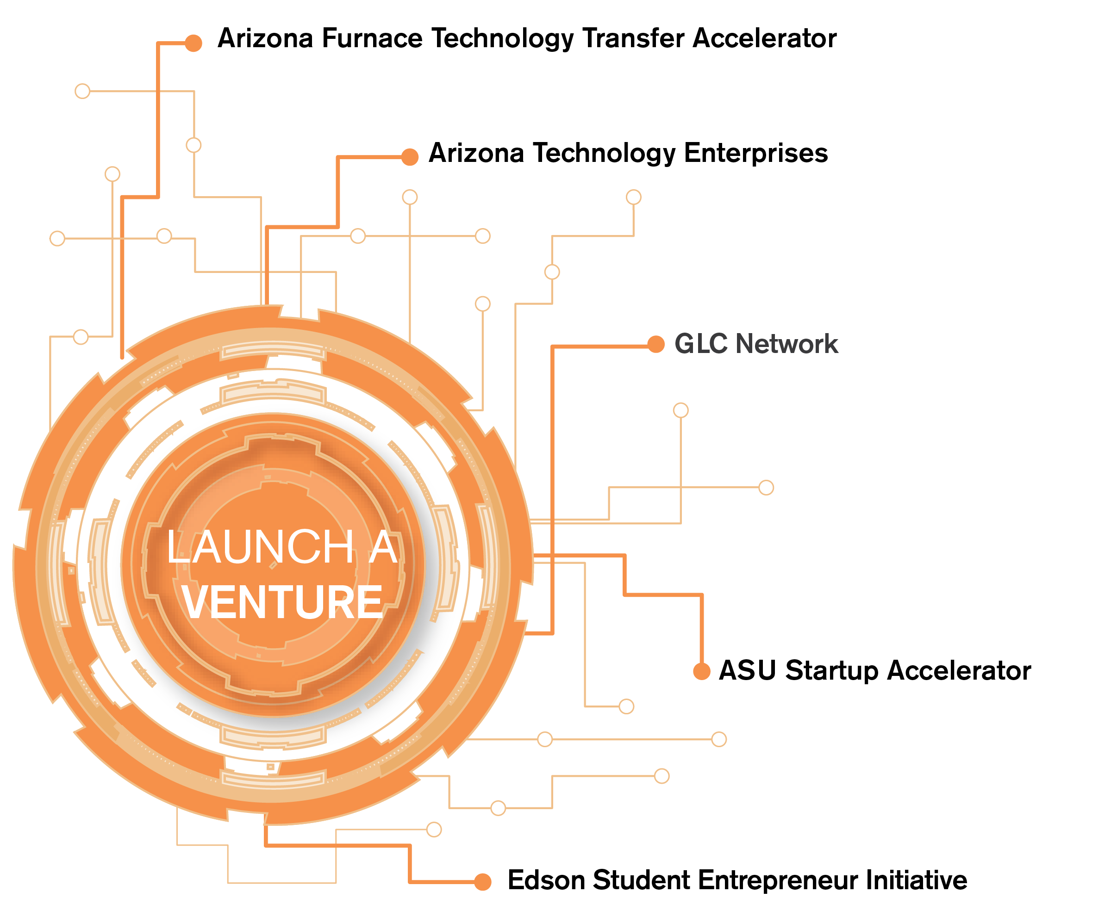
(EIG initiative)
(EIG initiative)
(EIG initiative)
(EIG initiative)

Slide 22
Furnace Technology Transfer Accelerator – first in the world
Furnace is a methodology and system to support existing technology transfer objectives and operations
It is in part designed to solve the issue of organizations that have unused but commercially viable technologies
It is a tested methodology that enables clusters of research institutions to target their intellectual property to different target groups
University Intellectual Property is managed by the universities on behalf of the tax payer (US law)

Slide 23
Furnace: a flexible system to drive tech transfer
Objective is to ‘push’ intellectual property out of research institutions and into the marketplace
It can be set-up to create new startups based on this IP
Or it could be used to support TTO’s in pushing technologies for licensing to large or small companies
This would be in particular where TTO activities are in the early stages in the research partners
The objectives are set by the cluster of partners involved in the Furnace in any given region
Creating new startups is the number one interest in terms of other Furnace locations objectives

Slide 24
Arizona Furnace Technology Transfer
Arizona Furnace (pilot)is designed to stimulate more startup activity
Created a successful public/private partnership
Over 200 patents were offered
Online competition application based around their proposed business model
22 semi-finalists, 10 winning teams
Each team created a new company
Fast licensing process from the relevant Technology Transfer Office
Good licensing terms for the new startup:
Downstream patent repayments
Single digit equity in new company
Total of $250,000 in startup state grant funding awarded to these ten new startups ($25,000 each)
Mayo Clinic has agreed to join Furnace 2.0
Technology Transfer Office Partners
Funding Partners
Support Partners
Notes:
First state-wide collaboration around tech transfer (3 state universities, one private hospital group) with now Mayo Clinic joining the second Furnace competition which started in Sept 13
Create New startups to commercialize technologies from Arizona universities and research institutions (207 patents available on Furnace website) www.azfurnace.org
Tied with an accelerator program of 6 months (Phoenix, Tucson, Flagstaff) and grants of $25K from state org’s
22 startup teams through to final pitching on 5th of Nov, 10 successful teams announced 16th Nov.
Because Furnace startups are tech transfer related, need more specific mentors with energy, medical device, hardware backgrounds
Received EDA grant to support it

Slide 25
Results
RehabDev

Slide 26
ASU Edson Student Entrepreneur Initiative (Accelerator)
Startup accelerator for student-run ventures
Funded through privately financed endowment (Edson family; Bayliner Boats)
Started as experiential learning, repositioned as an accelerator in 2011
ASU takes no equity (unless based on ASU technologies)
Acceleration period is 10 months long
24/7 access to dedicated space and EIG service in ASU SkySong
Heavily mentor-led like other accelerator programs
Decentralized approach to entrepreneurship teaching = diverse startups:
For-profit, more-than-profit and social enterprises
Medical devices, consumer products, social innovations, software and hardware
Approximately 20 student-led startup teams are chosen each year
Startups receive approximately $200,000 in direct (endowed) funding or up to $20,000 per startup
Each startup team also gets potential access to additional funding:
Patent/Copyright/Trademark fund ($60,000 in total)
A customer engagement & biz development travel fund ($30,000 in total)

Slide 27
ASU Edson Successes – Local, National, International
An Edson startup has made the final five in Entrepreneur magazine’s ‘College Entrepreneur of the Year’ for three years in a row (2011, 2012, 2013) including the 2011 winner
ASU Edson startups have also placed second in the ‘Idea to Product’ Global Competition two years in a row (2011, 2012)
Inc. magazine’s ‘Coolest College Startup in America’
- 2011: Two finalists – first (Endless Entertainment) and second place overall (first time)
- 2012: One finalist
Edson companies have made the finals in over two dozen competitions including in the US, Europe and Asia
An ASU Edson startup, Pollen Tech won the inaugural “best Arizona student startup company” competition in 2013
Since Sept 2011 Edson companies have won almost $2 million in grant, competition and venture funding

Slide 28
Campus-wide Student Startup Support Systems - GLC
The Great Little Companies (GLC) network is funded through new private funding received in 2013
An additional $100,000 a year in direct funding in addition to those on the Edson program
It is a campus-based support structure through leveraging the Changemaker locations on each campus
Creates additional structure to support more student startups
Up to an additional 30 student startups can be supported
These student startups will access:
Small amounts of funding ($3-4,000 per team)
Mentor and EIG team support
Interactions will take place in Changemaker locations

Slide 29
ASU (External) Startup Accelerator
Moving from random external companies to a 6 months cohort system of 6-10 startups at a time
Includes external (non-ASU), ASU faculty (non-Furnace) and ASU alumni startups
Offered a full pracademic program, mentor-led, co-working space in ASU SkySong
These companies are early stage but high potential startups (HPSU)
Some companies are too early to engage – send to outside groups such as the SCORE (mentor group)
Objective – to create sustainable businesses to create jobs and wealth particularly for Arizona
Majority of the new startups are based in the dedicated co-working space in ASU SkySong

Slide 30
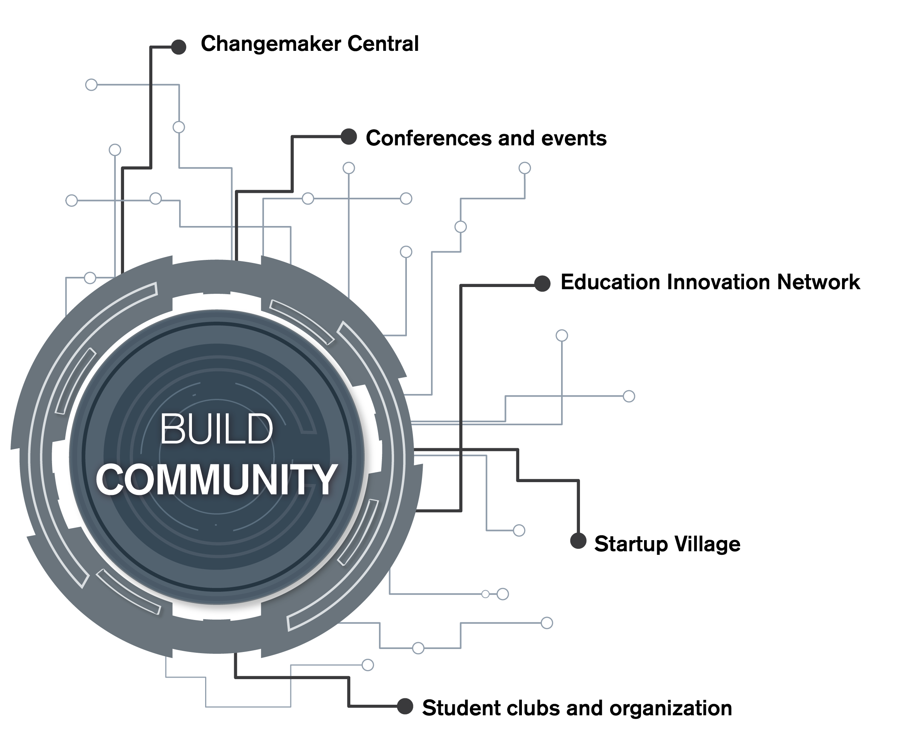

Slide 31
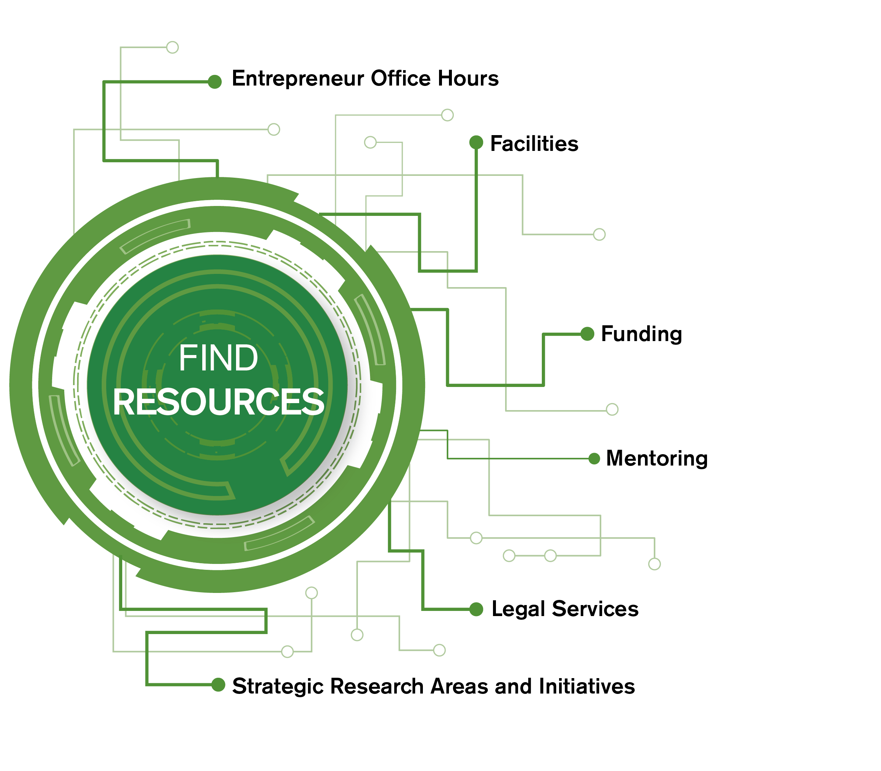
(EIG initiative)
(EIG initiative)

Slide 32
Entrepreneurship as a Permanent Revolution
Using ASU and Arizona as a ‘petri’ dish for Experimentation
Develop new concepts untried elsewhere
Aim to stimulate entrepreneurship activity inside and outside the university
Constantly test and refine in Arizona
Then propagate these ideas in other cities, states, countries

