Slide 1
Entrepreneurship & Innovation Group
Furnace Technology Transfer Accelerator
By: Gordon McConnell
Assistant Vice-President
Entrepreneurship and Innovation

Slide 2
Background to asu eig

Slide 3
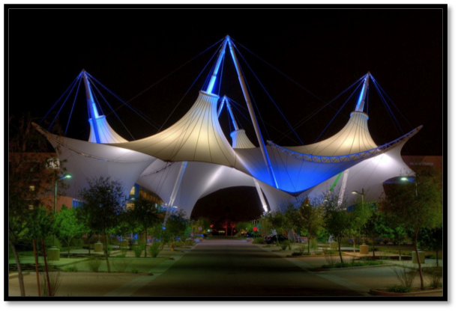
SkySong Overview
A 42-acre mixed-business-use development located in Scottsdale, Ariz.
A public-private partnership
A joint venture with the university, city of Scottsdale, ASU Foundation and Plaza Companies
Home to a global business community
Links technology, entrepreneurship, innovation and education
Positions ASU and Greater Phoenix as global leaders of the knowledge economy
More than 800 tech-related jobs
97 percent capacity
Buildings 3 & 4 in planning stages; 400 apartments under construction

Slide 4
SkySong Overview
Designed to:
Create an ecology of collaboration and innovation
Target high-profile technology enterprises and related researchers
Advance global business objectives of on-site enterprises
Raise Arizona’s profile as a global center of innovation
Create a unique regional economic and social asset
Tenants range from large companies such as Ticketmaster to early-stage startups – over 70 companies
ASU SkySong, also known internally as Economic Development and Corporate Engagement (EDCE),
a unit of the Office of Knowledge Enterprise Development, the research wing of the university.
Occupies two floors of SkySong Building 1
Consists of three sub-units, including the Entrepreneurship and Innovation Group at ASU

Slide 5
ASU Entrepreneurship and Innovation Group (EIG) Overview
Originally created in October 2010 as ASU Venture Catalyst
Renamed in June 2013 as the EIG and based in the ASU SkySong Innovation Center (Scottsdale)
Part of the Office of Knowledge Enterprise Development (OKED) and works closely with AzTE (ASU’s technology transfer arm )
Tasked recently with a wider role of helping coordinating entrepreneurship across the university, as well as specific task to manage ASU’s startup activities (student, staff, external)
Manages the incubation & accelerator initiatives in ASU including:
Student startups (Edson startup competition, new Great Little Companies (GLC) Network
Supports faculty spinouts after licensing occurs with ASU’s AzTE
Runs state-wide technology transfer accelerator that turns unused Intellectual Property into startup companies (Furnace)
Supports a growing network of startup coworking spaces in the public libraries called the Alexandria Network
Named one of the top 20 University Incubators in the world 2013 by the UBI Index (10th in the US); winner of the national award for ‘Emerging Technology Based Economic Development’ (SSTI)
Develops Public/Private Partnerships e.g. Microsoft alliance, members of Techstars Global Accelerator Network (GAN), collaboration with cities, ACA etc

Slide 6
Core Values for the ASU EIG
Representing One View, One Voice
Experimentation through Innovation
Continuous Improvement & Refinement
Replicating our Great Ideas in Other Places
Open Collaboration Inside and Outside
Pracademic Approach & Mentor-led

Slide 7
Entrepreneurship@ ASU – A Permanent Revolution

Slide 8
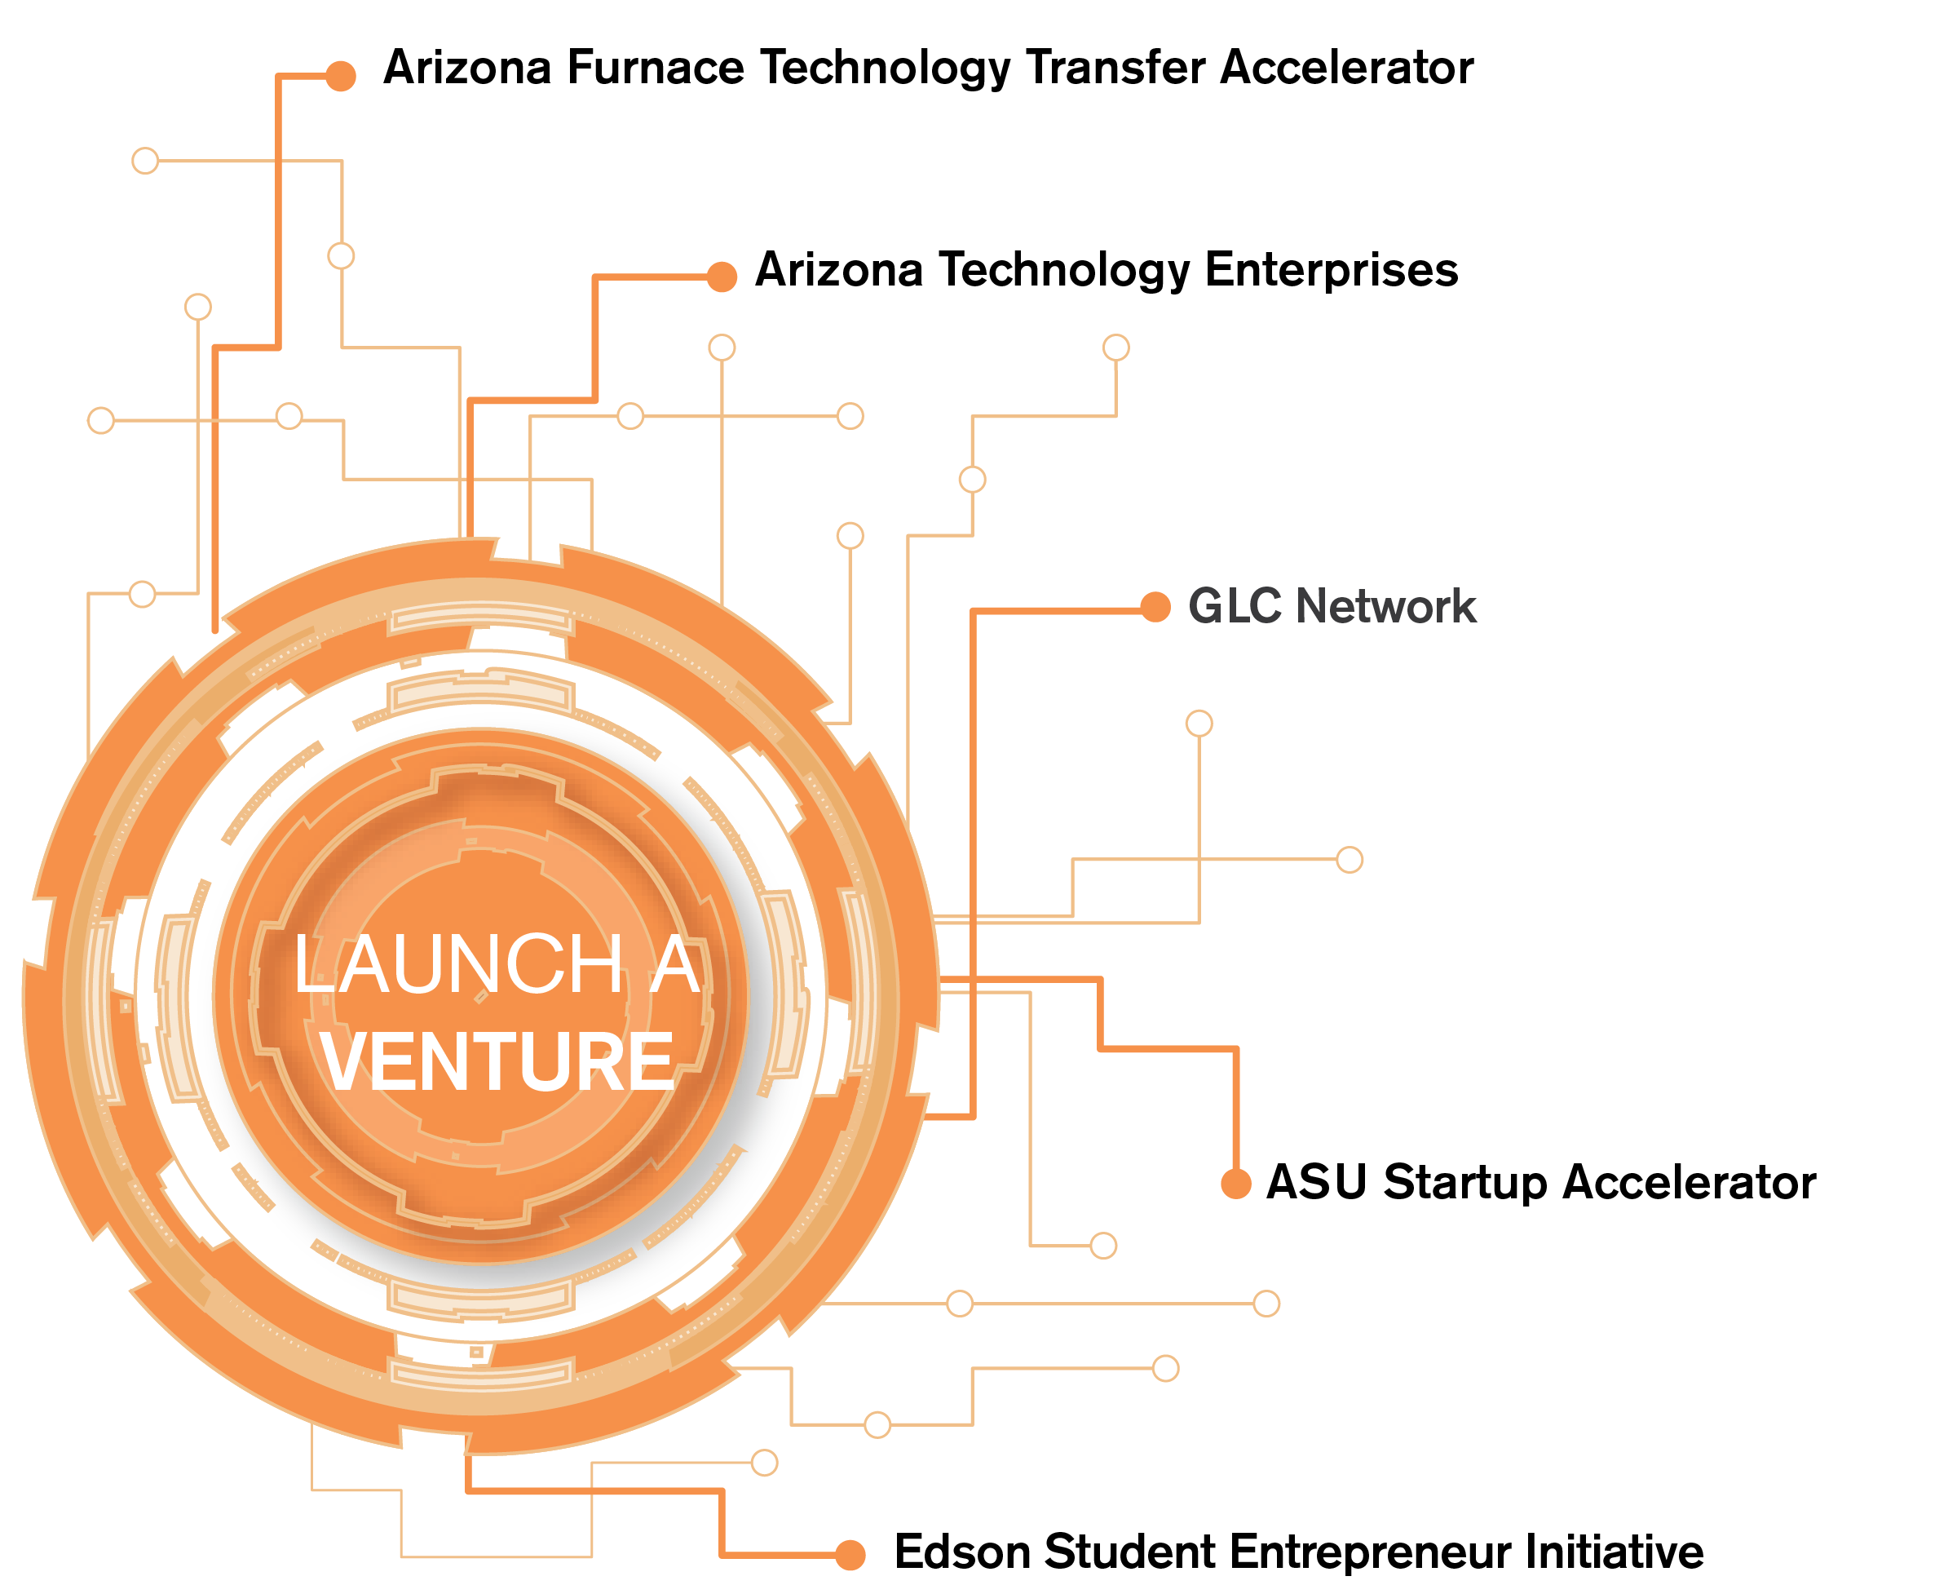

Slide 9
Why furnace?

Slide 10
The Problem with Technology Transfer
All research institutions have the same issue: majority of their patents are never used (95%)
Yet these patents were created via a huge investment in research spending (often publically funded)
Coupled with the cost of the patenting process
Technology Transfer Offices tend to be small; concentrate on licensing to large companies
In particular there is a lack of engagement with internal and external entrepreneurs
TTO operations generally don’t have the means or ability to successfully ‘mass market’ to different groups e.g. corporates, small business, entrepreneurs

Slide 11
Furnace Technology Transfer Accelerator – first in the world
Furnace is a methodology and system to support existing technology transfer objectives and operations
It is in part designed to solve the issue of organizations that have unused but commercially viable technologies
It is a tested methodology that enables clusters of research institutions to target their intellectual property to different target groups
It was first tested in Arizona, and will be adapted for use by clusters of research partners in Southern California and Texas in early 2014
Interest in Furnace has come in from around the world including Mexico, Canada and China

Slide 12
Furnace: a flexible system to drive tech transfer
The Furnace methodology is designed to be a flexible system
Objective is to ‘push’ intellectual property out of research institutions and into the marketplace
It can be set-up to create new startups based on this IP
Or it could be used to support TTO’s in pushing technologies for licensing to large or small companies
This would be in particular where TTO activities are in the early stages in the research partners
The objectives are set by the cluster of partners involved in the Furnace in any given region
Creating new startups is the number one interest in terms of other Furnace locations objectives

Slide 13
Starts with Objectives of the TTO’s
At the heart of Furnace is the technology transfer offices of the research partners
The cluster of partners who participate via their intellectual property need to be clear on their objectives:
Do they want to increase the number of new startups?
Do they want to drive faculty-led startups?
Do they want to promote their technologies to external commercial organizations?
Once the objectives have been clarified then the Furnace methodology can be applied that situation
Furnace Arizona also had the effect of increasing invention disclosures from faculty as a by-product

Slide 14
Furnace System

Slide 15
Furnace Structure
Furnace is managed by the ASU EIG as a key initiative
EIG created the methodology in early 2012
It combines the five key elements:
Partnership amongst a group of research institutions & Furnace
Application of the Furnace methodology to the IP portfolio
An offline/online marketing campaign
A competition process
Startup Acceleration for the cohort of winning startups
Funding
A pilot was run in Arizona with three universities and one private hospital group
Furnace 2.0 is being run in 2013/14 with the Mayo Clinic joining as an additional research partner

Slide 16
1. Partnerships
Needs a cluster of research organizations that have a patent portfolio
Should be in a relatively close proximity to each other
Organizations could be public or private or both
These entities could be:
Public or private universities
Research institutions or Hospitals
Government research institutions
Private companies
Partners must agree to:
Share their unencumbered patent portfolios with the Furnace team
Must ensure there are no background issues with these technologies
Must agree to the triage/translation process
Must commit to a fast licensing process at the end of the competition process
Must commit to any payments or royalties will be downstream, based on revenue milestones
Must commit to not taking more than a single digit equity if the outcome is a new startup company

Slide 17
2. Furnace Methodology
Furnace methodology was developed by the ASU EIG
The Furnace ‘Playbook’ is the intellectual property of ASU
It involves:
Triage: the process of deciding what technologies are viable in the commercial world
Translation: making these technologies accessible to outside audiences
Furnace Social Cloud: Proprietary social media platform where the Furnace technologies are open to the world to see

Slide 18
3. Marketing Furnace
Communicating Furnace is a key element of the system
Includes offline and online activities coordinated by Furnace team
Offline activities include evangelizing the Furnace competition to key audiences depending on the application of the process:
Internal audiences including students, graduate students, postdocs, junior faculty, staff
External audiences including potential entrepreneurs, serial entrepreneurs, corporate individuals
Number of meet-up, Furnace information sessions/team building take place during the competition period
Online activities start with the social platform which Furnace uses to push the technologies
Linked with social media and mainstream media interactions

Slide 19
4. Competition Process
Competition period lasts several months
Similar to any accelerator competition e.g. Techstars
If the Furnace is designed to create new startups, team formation is a critical factor
Furnace social media platform and group events are a key part of this
Teams usually made up of external and internal team members e.g. serial entrepreneur, new entrepreneur plus a postdoc from the research team that created the technology
Competition application is online; asks key questions about the team and uses questions derived from the Business Model Canvas

Slide 20
5. Acceleration
If the Furnace process is aimed at creating new startups…
Taking best practice from the startup accelerator model (e.g. Techstars)
Key elements include:
An open competition to select a winning group
A chosen cohort of startups working in the same physical space
Support to create a minimum viable product
Mentor-led acceleration for a set period of time
Lean Startup and Business Model Canvas training
Preparation for fund raising
Demo Day in front of investors at the end of the time period (nine months)

Slide 21
6. Funding
A startup competition with seed funding is needed to really drive interest
Arizona Furnace pilot had $25000 in grant funding (no equity) from two state organizations
For a Furnace adaptation that is aimed at creating new startups the funding can come from several sources:
National or regional organizations giving grants to create new companies/jobs (usually new equity taken from startups)
A fund created through corporate social responsibility (brand and marketing exposure, no equity taken)
Private funding through a special purpose vehicle (could be corporate or group of individuals, equity taken)
Funding via the research partners (philanthropic)

Slide 22
Furnace arizona

Slide 23
Pilot – Furnace Arizona 2012/13
Three state universities (ASU, NAU and University of Arizona)
Over $1 billion in federal research funding for state universities in Az a year
Almost 600 patents and technologies collectively not being used
Only circa 20 startups coming out of tech transfer a year in Arizona
Yet by AUTM metrics this is ‘good’?
How to connect entrepreneurship activities in the university with tech transfer?
Similar issues across the US, around the world

Slide 24
Furnace Technology Transfer Accelerator Pilot Partner
Technology Transfer Office Partners
Funding Partners
Support Partners
Notes:
First state-wide collaboration around tech transfer (3 state universities, one private hospital group)
Create New startups to commercialize technologies from Arizona universities and research institutions (207 patents available on Furnace website) www.azfurnace.org
Tied with an accelerator program of 6 months (Phoenix, Tucson, Flagstaff) and grants of $25K from state org’s
22 startup teams through to final pitching on 5th of Nov, 10 successful teams announced 16th Nov.
Because Furnace startups are tech transfer related, need more specific mentors with energy, medical device, hardware backgrounds
Received EDA grant to support it

Slide 25
Furnace Technology Transfer Accelerator – first in the world
Furnace Arizona was originally designed to stimulate more startup activity:
Take the best, unencumbered technologies from Arizona research institutions
Translate, position and promote them
Help create diverse teams: external entrepreneurs/graduate students/junior faculty
Offer acceleration and $25K in grant funding each
Pilot in 2012 resulted in ten new startups:
Created a successful public/private partnership
Over 200 patents, copyrights uploaded to Furnace website (after ‘translation’)
Over 50 applications, 22 finalists, 10 chosen startup teams
Total of $250,000 in startup state grant funding awarded
Notes:
First state-wide collaboration around tech transfer (3 state universities, one private hospital group)
Create New startups to commercialize technologies from Arizona universities and research institutions (207 patents available on Furnace website) www.azfurnace.org
Tied with an accelerator program of 6 months (Phoenix, Tucson, Flagstaff) and grants of $25K from state org’s
22 startup teams through to final pitching on 5th of Nov, 10 successful teams announced 16th Nov.
Because Furnace startups are tech transfer related, need more specific mentors with energy, medical device, hardware backgrounds
Received EDA grant to support it

Slide 26
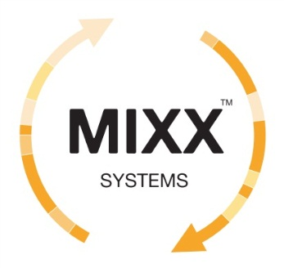
results

Slide 27
Entrepreneurship as a Permanent Revolution
Using ASU and Arizona as a ‘petri’ dish for Experimentation
Develop new concepts untried elsewhere
Aim to stimulate entrepreneurship activity inside and outside the university
Constantly test and refine in Arizona
Then propagate these ideas in other cities, states, countries

